Slide 1
PSYCHOANALYTIC CRITICISM
Freud and His Contribution to Literary Theory
A PowerPoint Spectacular by C.J. Fusco

Slide 2
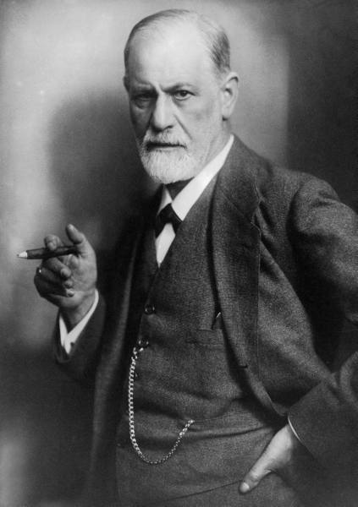
Sigmund Freud
Sigismund Schlomo Freud (1856-1939), was an Austrian neurologist usually credited with creating psychoanalytic theory and, by extension, psychiatric therapy.
Freud believed that unconscious sexual drives were the basis for all human behavior, and that dreams were an important indicator for understanding human behavior.

Slide 3
Psychoanalysis
Called “the talking cure” by Freud’s most famous patient, “Anna O.”, psychoanalysis was an attempt to unseat deeply-rooted memories bound to conflict, insecurity, trauma, and the like. Through dialogue, Freud and colleagues believed, the patient’s issues would “out” themselves and the patient could eventually live a life of what Freud called “ordinary misery”.

Slide 4
The Freudian Mind
The conscious mind is the part of the mind that interacts with the outside world. It is the decisions we make and the actual thinking we do.
The unconscious mind is made up of the impulses and instincts that dictate our behavior without us knowing about it; Freud believed these impulses were driven by sexuality, Jung believed they were driven by cultural archetypes, and some other psychologists believe the unconscious mind to be made of drives for power, for love, or for any other number of impulses.

Slide 5
The Three Tiers of “Self”
“Schlomo” broke down the unconscious into three components that dictate conscious human behavior:
The ID seeks pleasure and avoids pain; we normally associate inborn instincts (such as the behaviors of an infant or an animal) with the id.
The EGO seeks to placate the id, but in a way that will ensure long-term benefits (such as trying to get what the id wants without breaking laws or social standards). Mediates between the id and reality. Maintains our “self – how we see our “self” and wish others to see it.
The SUPER-EGO is a lot like a conscience – it punishes misbehavior with feelings of guilt. Since the super-ego is concerned with societal norms, it stands in opposition to the id. The development of an individual’s super-ego replaces a parent’s discipline.

Slide 6
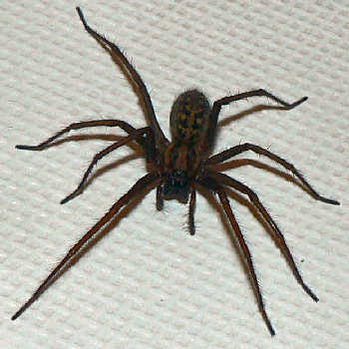
Primal Fears
Probably self-explanatory, primal fears/wishes are those fears/wishes we harbor within us that unconsciously shape our behaviors. These fears/wishes are rooted in “associations” or experiences where the fears initially formed and took root.

Slide 7
Sublimation
The process of repressing or restraining memories, fantasies, urges, or insecurities that threaten to unseat the conceptions of ourselves we’d most like to present to the world. According to Freud, sublimated thoughts and memories cannot remain sublimated forever. Because of a number of factors, they will eventually “rise” and what better way to deal with them before they do than through psychoanalysis?

Slide 8
Latency
Something that lies partially in the unconscious during what Freud coined its “gestation period.” A life experience can trigger it’s ultimate surfacing. Latency periods determine one’s future neurosis or normalcy. (e.g., someone who’s harboring deep-seated fears of public speaking).

Slide 9
Objectification
This term is used to describe the treatment of a human being or animal as a thing, disregarding his/her personality or sentience. Philosopher Martha Naussbaum has argued that something is objectified if any of the following factors is present:
Instrumentality – if the thing is treated as a tool for one's own purposes;
Denial of autonomy – if the thing is treated as if lacking in agency or self-determination;
Inertness – if the thing is treated as if lacking in agency/free will;
Ownership – if the thing is treated as if owned by another;
Fungibility – if the thing is treated as if interchangeable with another object;
Violability – if the thing is treated as if permissible to damage or destroy;
Denial of subjectivity – if the thing is treated as if there is no need to show concern for the 'object's' feelings and experiences.

Slide 10
Projection and Displacement
* The transference of uncertain, unsettled or unwanted feelings about ourselves onto someone or something else rather than coming to terms with them ourselves is called projection.
* When we displace or reassign our particular energies and/or interests that may threaten our status quo onto something or someone else, it’s called displacement. (Consider a mid-life crisis in which a man might buy a new sports car and date a younger woman in an attempt to displace his worries about aging and his desire for a new life).

Slide 11
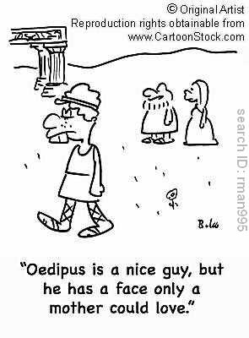
The Oedipus Complex
Essentially, it involves children's need for their parents and the conflict that arises as children mature and realize they are not the absolute focus of their opposite-gendered parent’s attention.
The literal version of the Oedipal/Electra complex is that the child wants to “marry” their opposite-gendered parent, but might figuratively refer to a desire to go back to an earlier stage of connectedness to that parent (“back to the womb,” if you will).

Slide 12
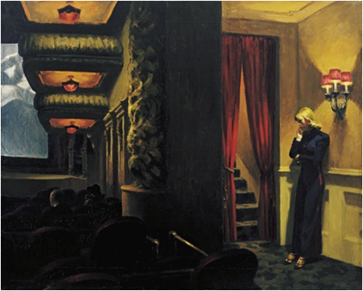
The Locus of Control
According to Freud, humans possess internal and external “locus of control”, or, rather, places that are the source of our sense of control in our lives. For example, if we have a high external locus of control, we believe our life is defined primarily by forces OUTSIDE of us such as family, social codes, the general environment, etc. If we have a high internal locus of control, we believe our life is defined primarily by forces INSIDE of us such as through intellect, skill, will, discipline, good luck, etc.

Slide 13
Psychoanalytic Literary Criticism
Adopts the methods of "reading" employed by Freud and later theorists to interpret texts. It argues that literary texts, like dreams, express the secret unconscious desires and anxieties of the author, that a literary work is a manifestation of the author's own neuroses. It approaches an author’s work as a kind of textual “talk therapy”.
One may psychoanalyze a particular character within a literary work, but it is usually assumed that all such characters are projections of the author's psyche.
Like psychoanalysis itself, this critical endeavor seeks evidence of unresolved emotions, psychological conflicts, guilt, ambivalences, and so forth within the author’s literary work. The author's own childhood traumas, family life, sexual conflicts, fixations, and such will be traceable within the behavior of the characters in the literary work.

Slide 14
Psychoanalytic Criticism, cont’d
Despite the importance of the author here, psychoanalytic criticism is similar to New Criticism in not concerning itself with "what the author intended." But what the author never intended (that is, repressed) is sought. The unconscious material has been distorted by the censoring conscious mind.
Psychoanalytic critics will ask such questions as, "What is Hamlet's problem?" or "Why can't Brontë seem to portray any positive mother figures?"

Slide 15
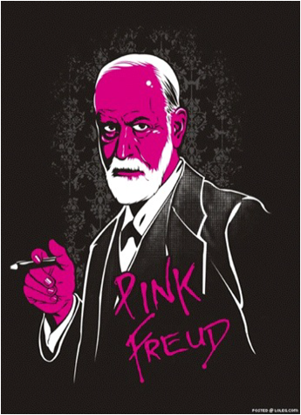
The End

